Slide 1
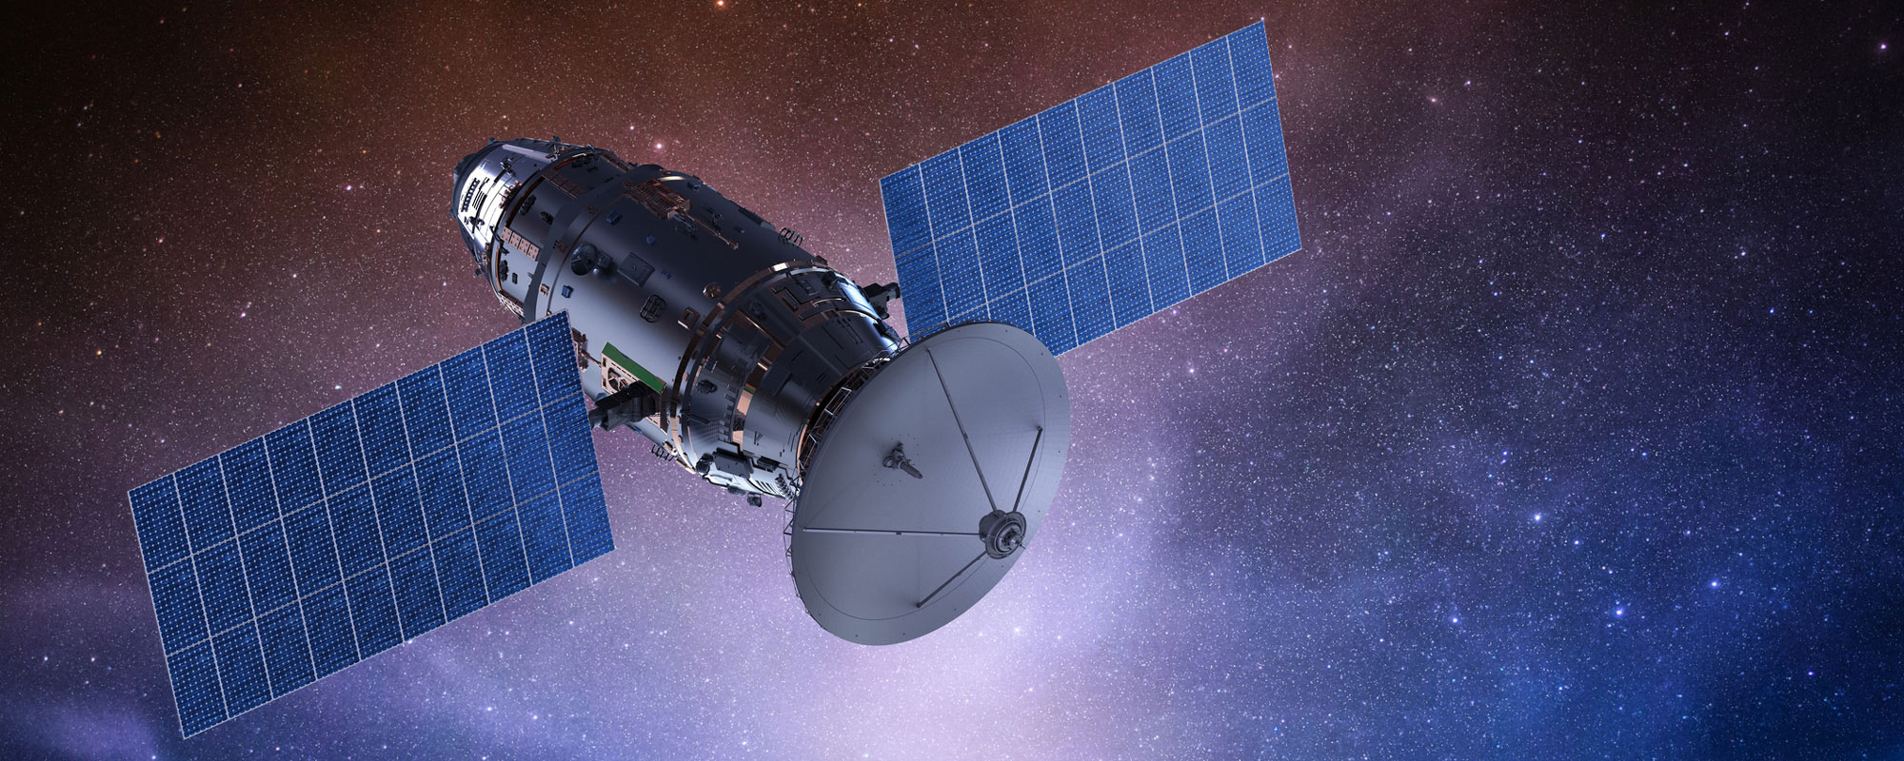
Cyber security in satellite Communication
CS320 Data Communication: Final presentation
Kosuke Hisano

Slide 2
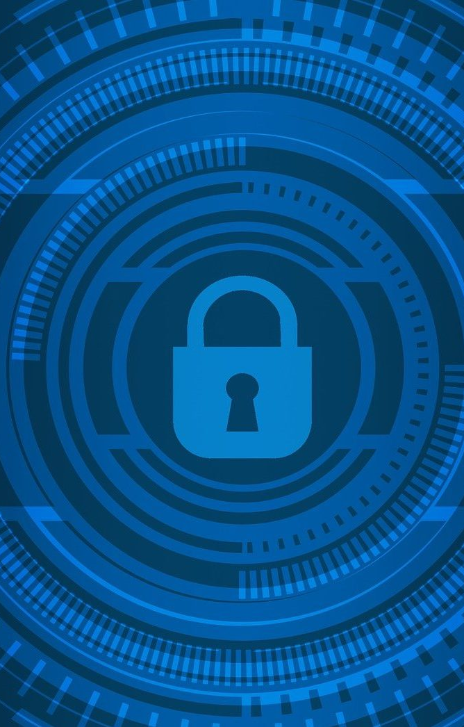
Table of Contents
Introducing modern satellite communication systems
Cyber Risks of Satellite Communication
How to Protect

Slide 3

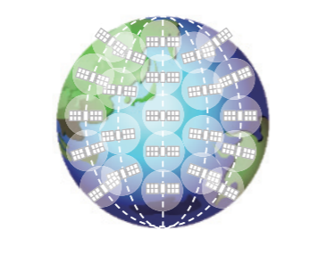
Satellite Communication System
Geosynchronous Satellite
Satellite Constellation

Slide 4
Cyber Risk of Satellite Communication
Increase the number of aging satellites
Many companies in the world launch satellites, and there are some satellites with less security or with traps like backdoor.
⇒easy target
Jamming
Cyber-attack (from the ground station)
Misuse of satellite communication
GPS Spoofing

Slide 5
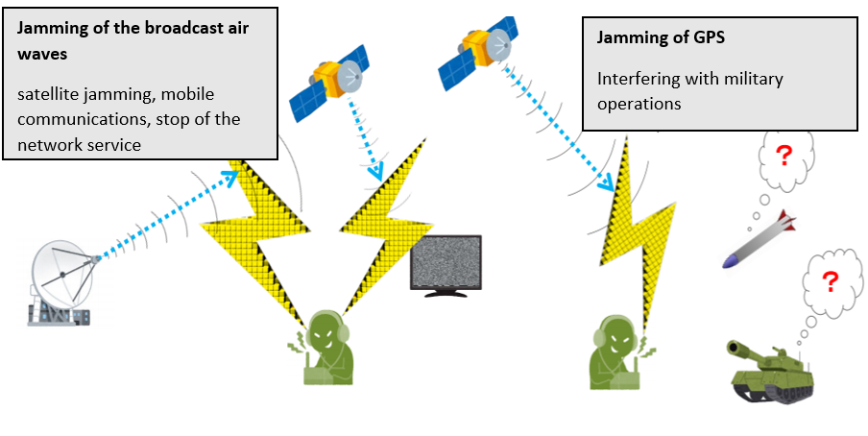
Jamming

Slide 6
Case:
Iran (2003)/ Jamming of broadcast air waves
An Iranian company jammed the British satellite broadcast airwaves of human rights group to Iran.
Iraq (2003)/ Jamming of GPS
The U.S. military destroyed six GPS signal jamming devices for the Iraqi Army’s guided weapons. Numerous cases of GPS signal jamming by such devices during the 2003 Iraq war.

Slide 7
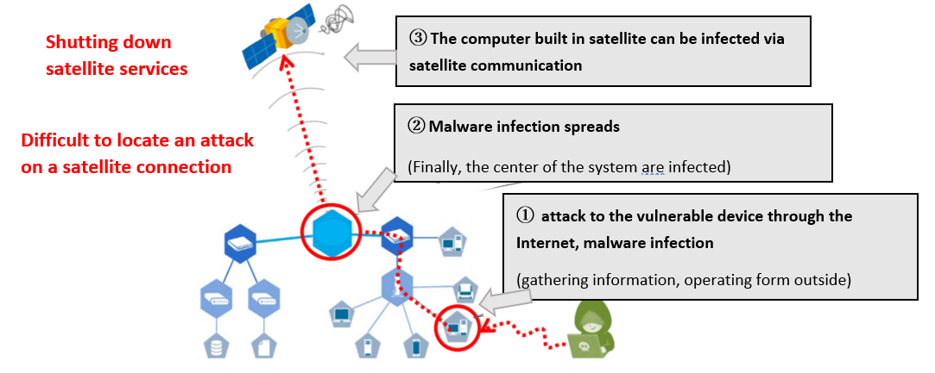
Cyber-attack from the ground station

Slide 8
Case:
America (2014)
The U.S. National Oceanic and Atmospheric Administration's (NOAA) weather observation network has been compromised by hackers who are suspected to be Chinese.
Weather data from NOAA's satellites was hacked. This includes important information used for hurricane predictions and other purposes.

Slide 9
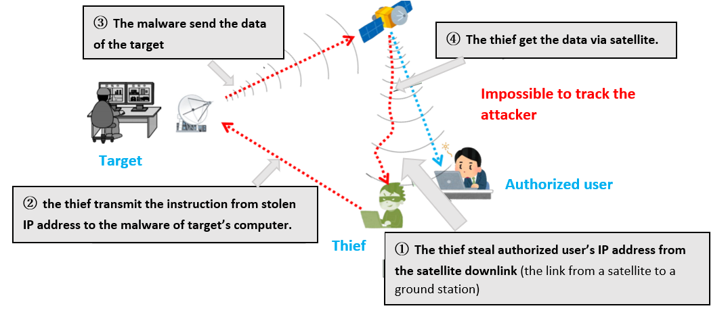
Misuse of communication satellite

Slide 10

Case:
Russia (2015- )/ Infiltrate their networks, spy
Cyber-attacks by the Turla, cyber spy group, believed to be related to Russia. Malware was infected by government agencies, the military, educational and pharmaceutical companies in more than 45 countries.

Slide 11
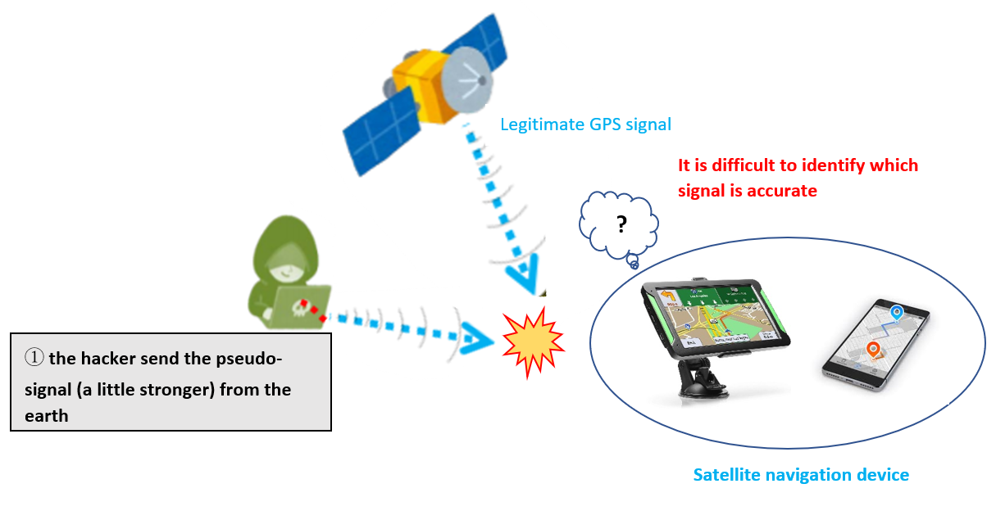
GPS spoofing

Slide 12
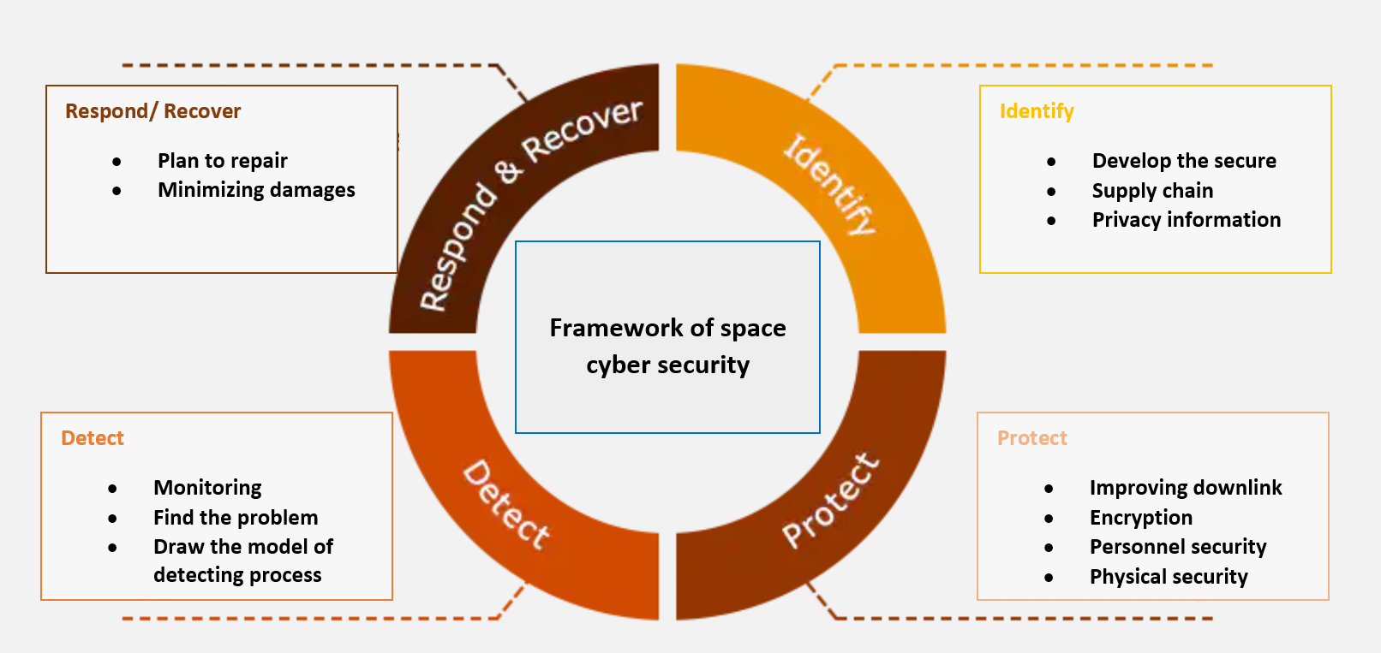
How to protect

Slide 13
How to protect: Jamming
Preparing and switching multiple frequency channels accordingly.
Switching communication routers (via other satellites) and changing communication times
Receiving signals from multiple GPS systems
Filtering
FIR filter: to improve the phase accuracy

Slide 14
How to protect: primary things
built device supply chain properly When producing satellites, you should examine the vulnerability It is encouraged to use the list in order to make sure of security
Device’s password should be changed Default passwords are changed before launching
In space, activating safely and managing equipments Periodically, send new passwords from the ground station through private lines Periodically, check the devices

Slide 15
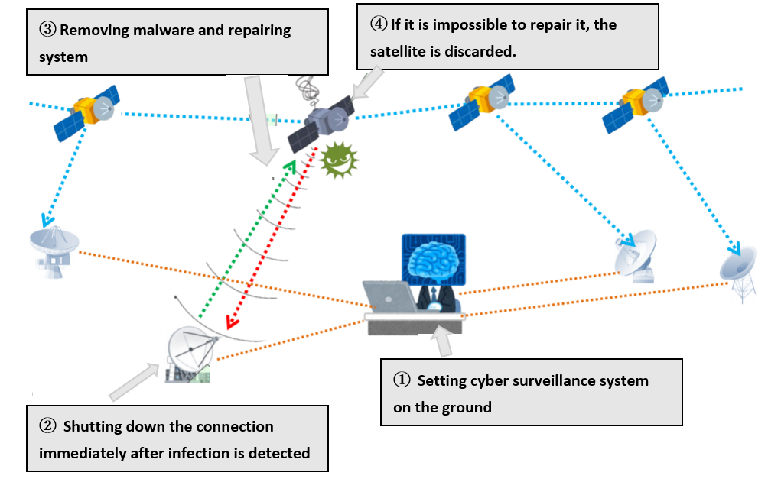
How to protect: Monitoring and removing malware

Slide 16
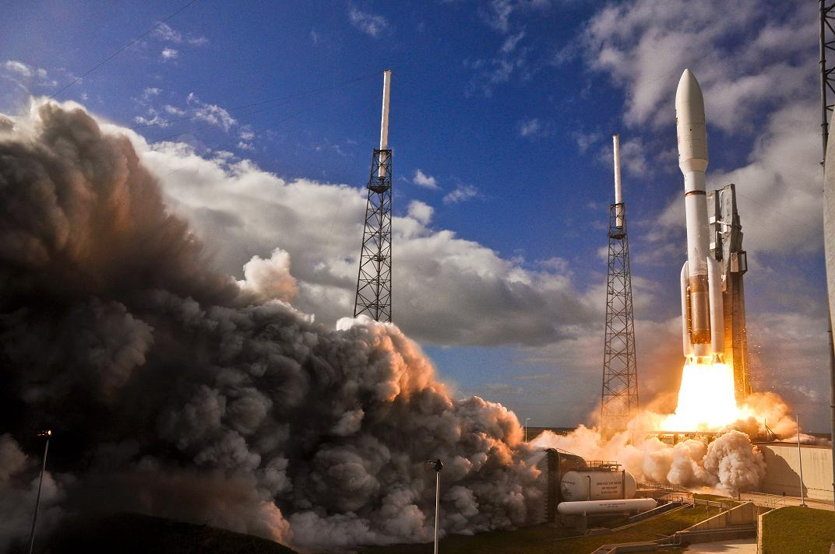
Thank you
Nov 10, 2020

